Slide 1
Perspectives on Continuous Integration at Scale
Hrishikesh Karekar @hrishikarekar
Vinaya Muralidharan @vinaya1980
August 2016

Slide 2


About us
Hrishi
Vinaya
Delivery CTO Organization
expertise
Change management
Promoting the best ways to deliver software

Slide 3
TRACK RECORD
Our track record is unmatched
161 PROJECTS INTO PRODUCTION ACROSS 46 CUSTOMERS IN THE LAST YEAR
120 PROJECTS RUNNING IN PARALLEL IN THE LAST YEAR
250 CUSTOMERS
30+ YEARS OF EXPERIENCE
AN OVER 95% SUCCESS RATE
5000+ DELIVERY EXPERTS

Slide 4

Projects @ Amdocs Delivery
What does Scale mean to you?
Distributed SITES
PBG
Delivery
CBG
Mega Transformations
MULTIPLE RELEASE TRAINS | SAFe
SI&O

Slide 5
Our Operating Environment

Slide 6
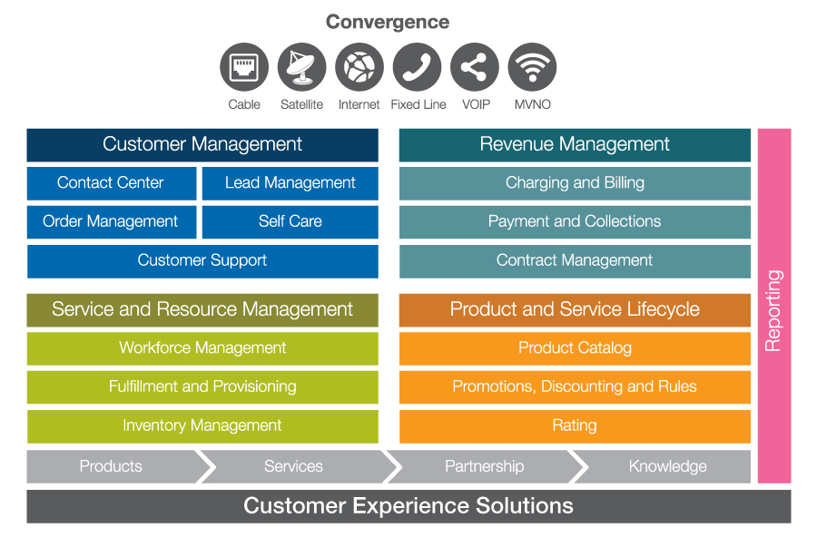
Amdocs CES

Slide 7
Technology
Service Delivery
Not Product Development
Traditional Automation
Record and Play
We are Unique
Array of homegrown tools & standards
Integration Challenges
Multi Product – Multi Technology – Multi Team
Legacy Infrastructure
Source control, Build Systems
Code works on my machine
Build is a big event
Takes days

Slide 8
Process
Large transformation projects
Upfront planning due to multi-vendor environment

Slide 9
People
Super specialization
Products
Competency Centers
No Scrum teams

Slide 10
Where are we today
Environments
Time to clone environment reduced due to EaaS
Build Time
Build Running every
13 days
8 Hrs
90%
4 Hrs
3
1
Weeks
Nights
Goal
Compilation no longer a blocker
Monthly ability to deliver working software to UAT
With major scope

Slide 11
Crafting a New Reality

Slide 12
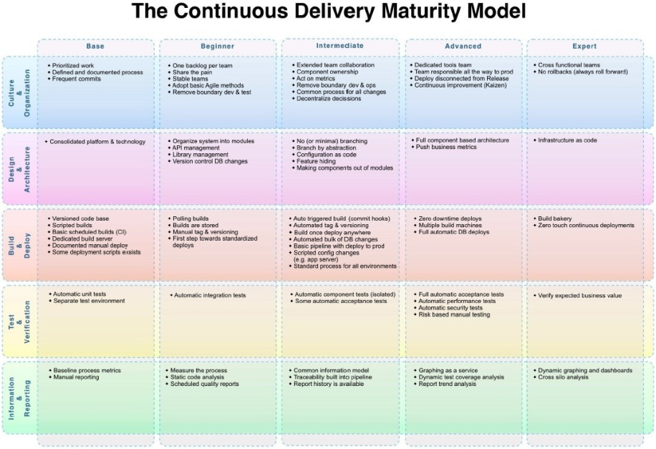
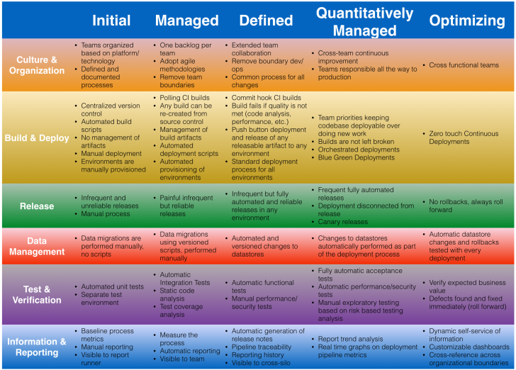
The Continuous Delivery Maturity Model
representative
http://www.infoq.com/articles/Continuous-Delivery-Maturity-Model
http://blog.arungupta.me/wp-content/uploads/2015/02/continuous-delivery-maturity-model-v1.0.png

Slide 13
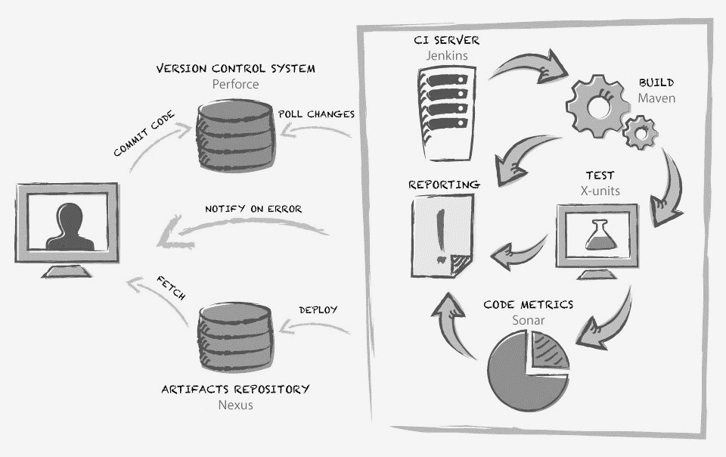
Starting to modernize

Slide 14
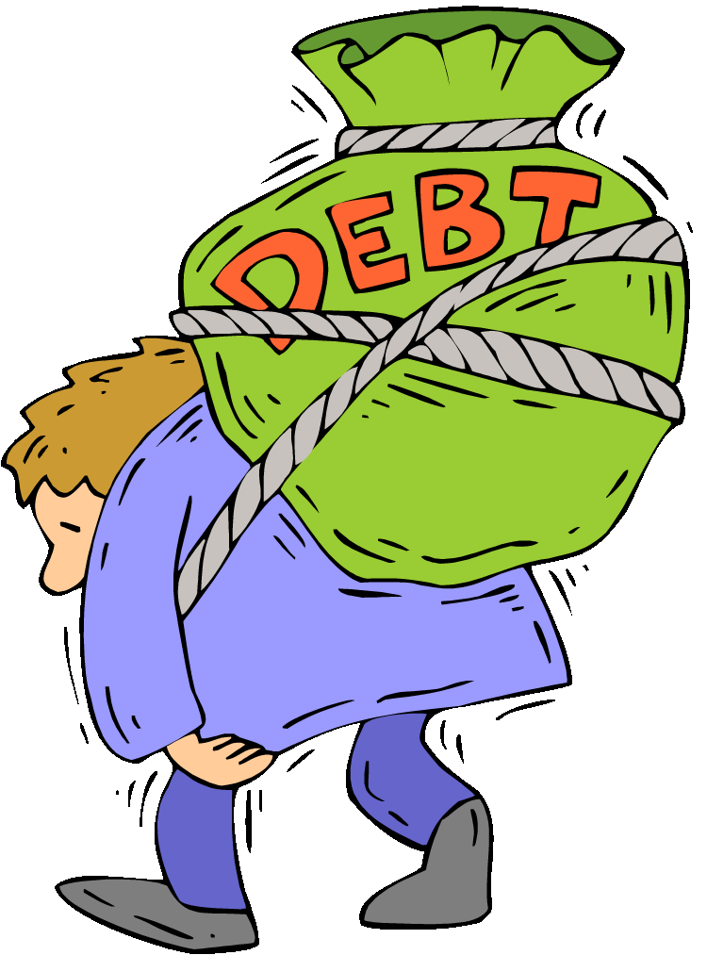
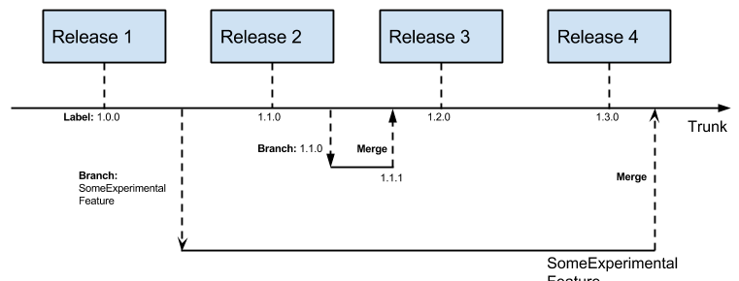
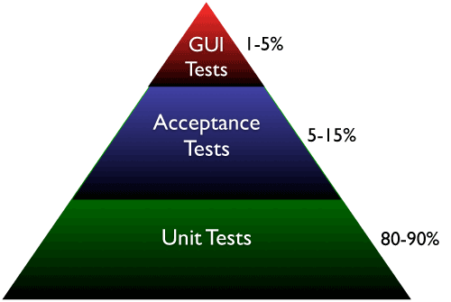

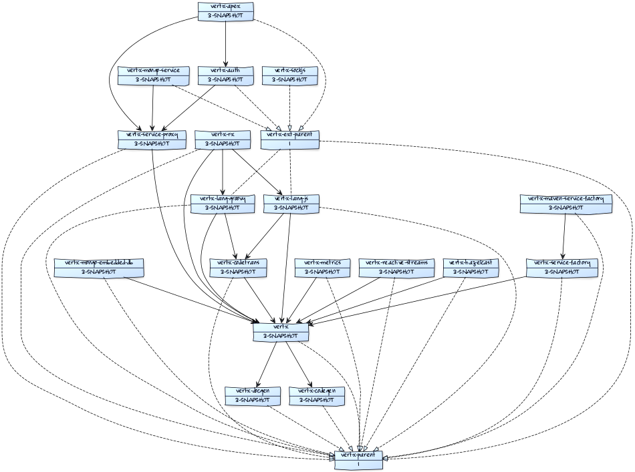

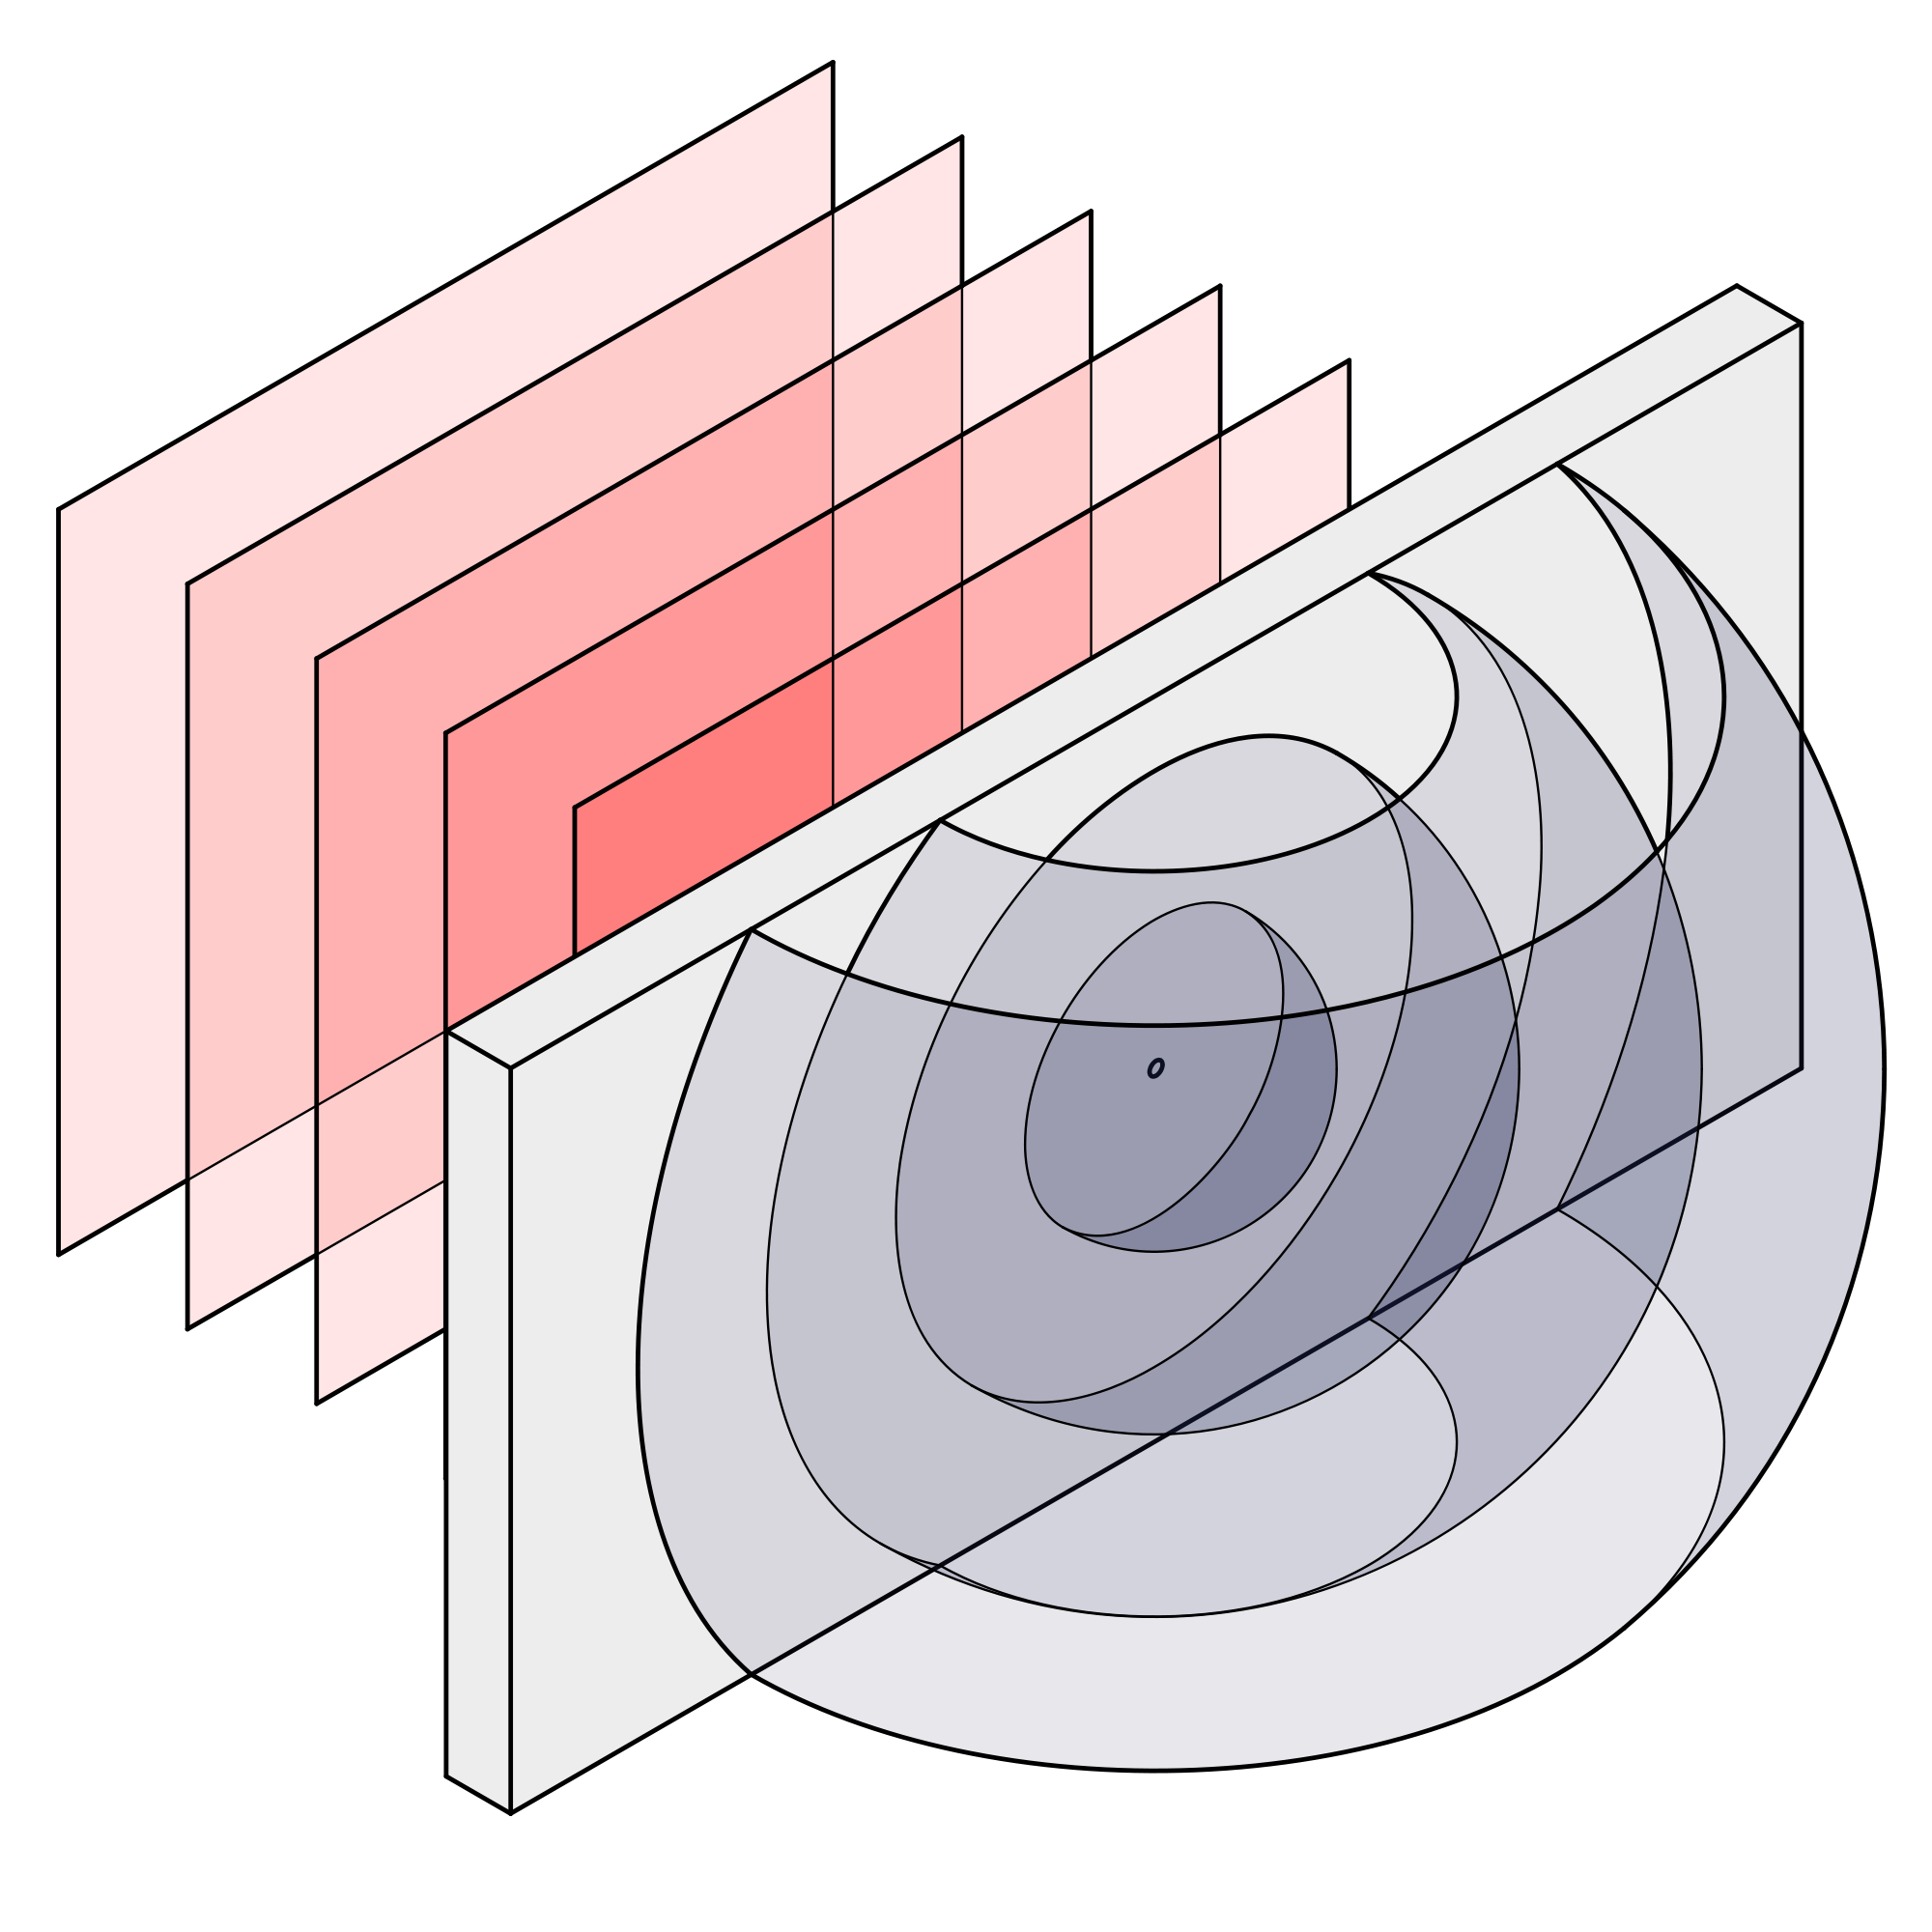
Technology
Technical debt
Modern Version Control system
Inverting the Test Automation pyramid
UT automation
Safety net for refactoring
Development Environment cloning
Simplified build order and dependency management
Modular builds
Moving from imperative to declarative
Artifact management
Measured and managed
Deploy portfolio integrated build

Slide 15






Process
Lean and visual documentation
Code Inspection approach
UT Defect logging
Software packages delivered more frequently
Frequent check-ins
Stop the line
Several times a day
Left to the teams
Lightweight and relevant

Slide 16
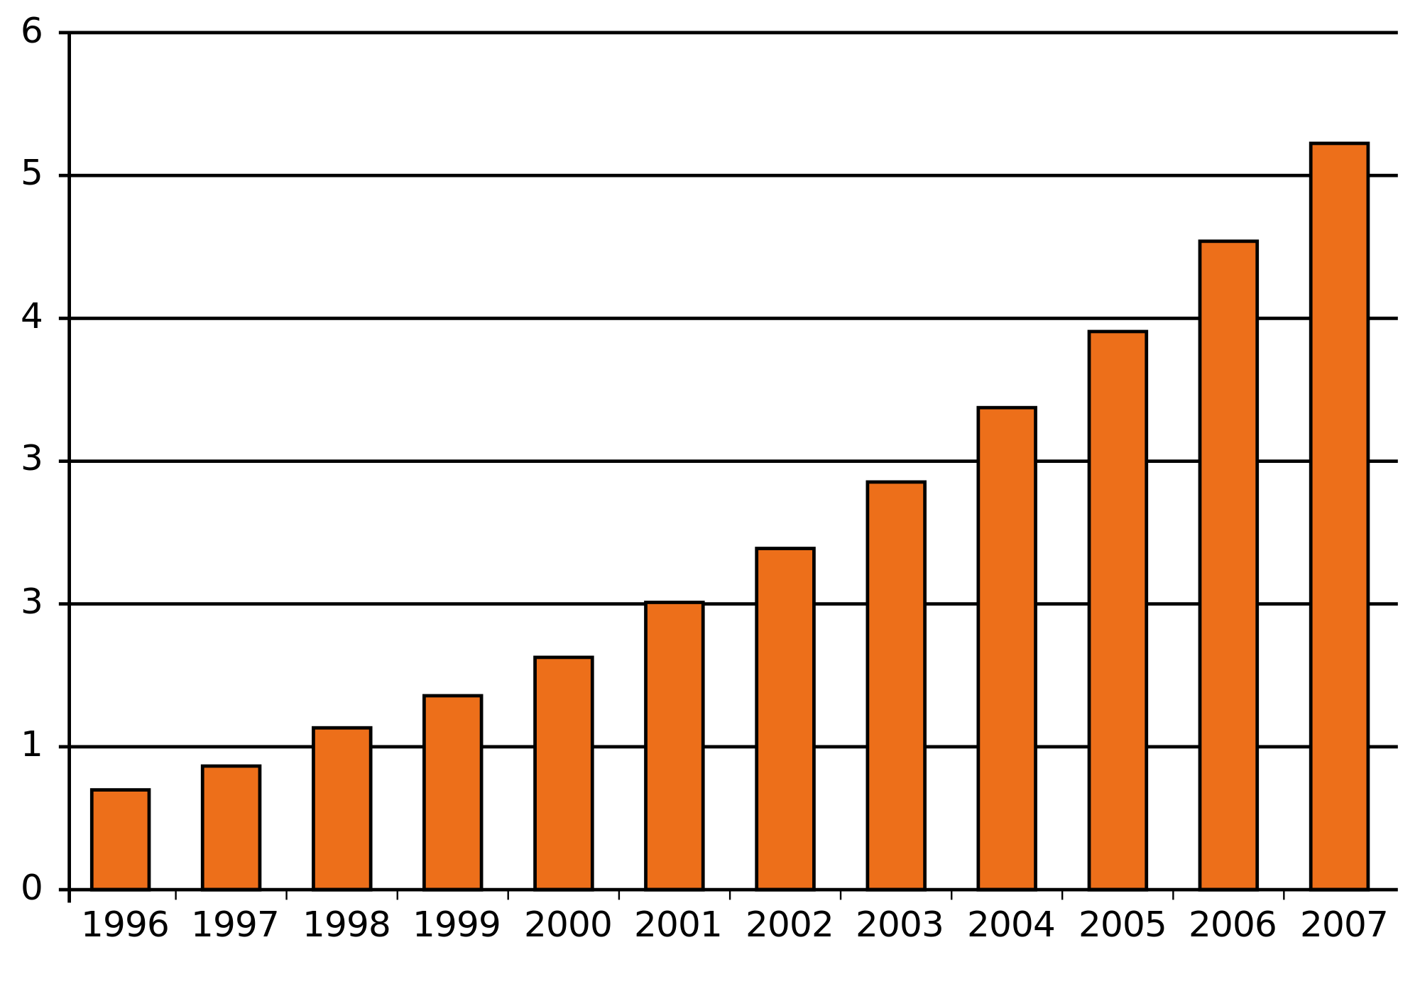


People
Developer viewed as craftsman
Developer engagement
Gamification
Improving developer productivity
Quality is everybody’s responsibility

Slide 17







Continuous Integration
EDGE OF INNOVATION
Version Control
Orchestrator & CI Server
Commit Code
Build
Fetch
Test
Environment As A Service
Notify on Error
System working
Artifacts Repository
Deployment
Code Metrics
Database
Security

Slide 18
Our learnings
One team cannot go CI
Daily check ins are a must
UT automation targets don’t work
CI Useless without automation
STOP the line is critical
Focus on clean code will go a long way
Rely more on build, not Hot Fixes
Don’t alienate middle management
Gamification
Sustain
Workshops

Slide 19














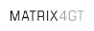
EDGE OF INNOVATION
Our roadmap
1
2
3
4
5
Improved Speed to Market
Continuous Integration & Delivery
Stability
Faster & Easier
Breaking Down Silos
Continuous Improvement
Optimization & leap forward
Stabilization
Laying the Foundation
Assessment
Solution Book
on site
2013
Setting the Basic foundation
2014
The year of Continuous integration
2015
The year of Agile in Scale
2016
The year of Technology Excitement
2017-18
Continuous
Delivery

Slide 20
Questions ?

Slide 21
Thank You

